Slide 1

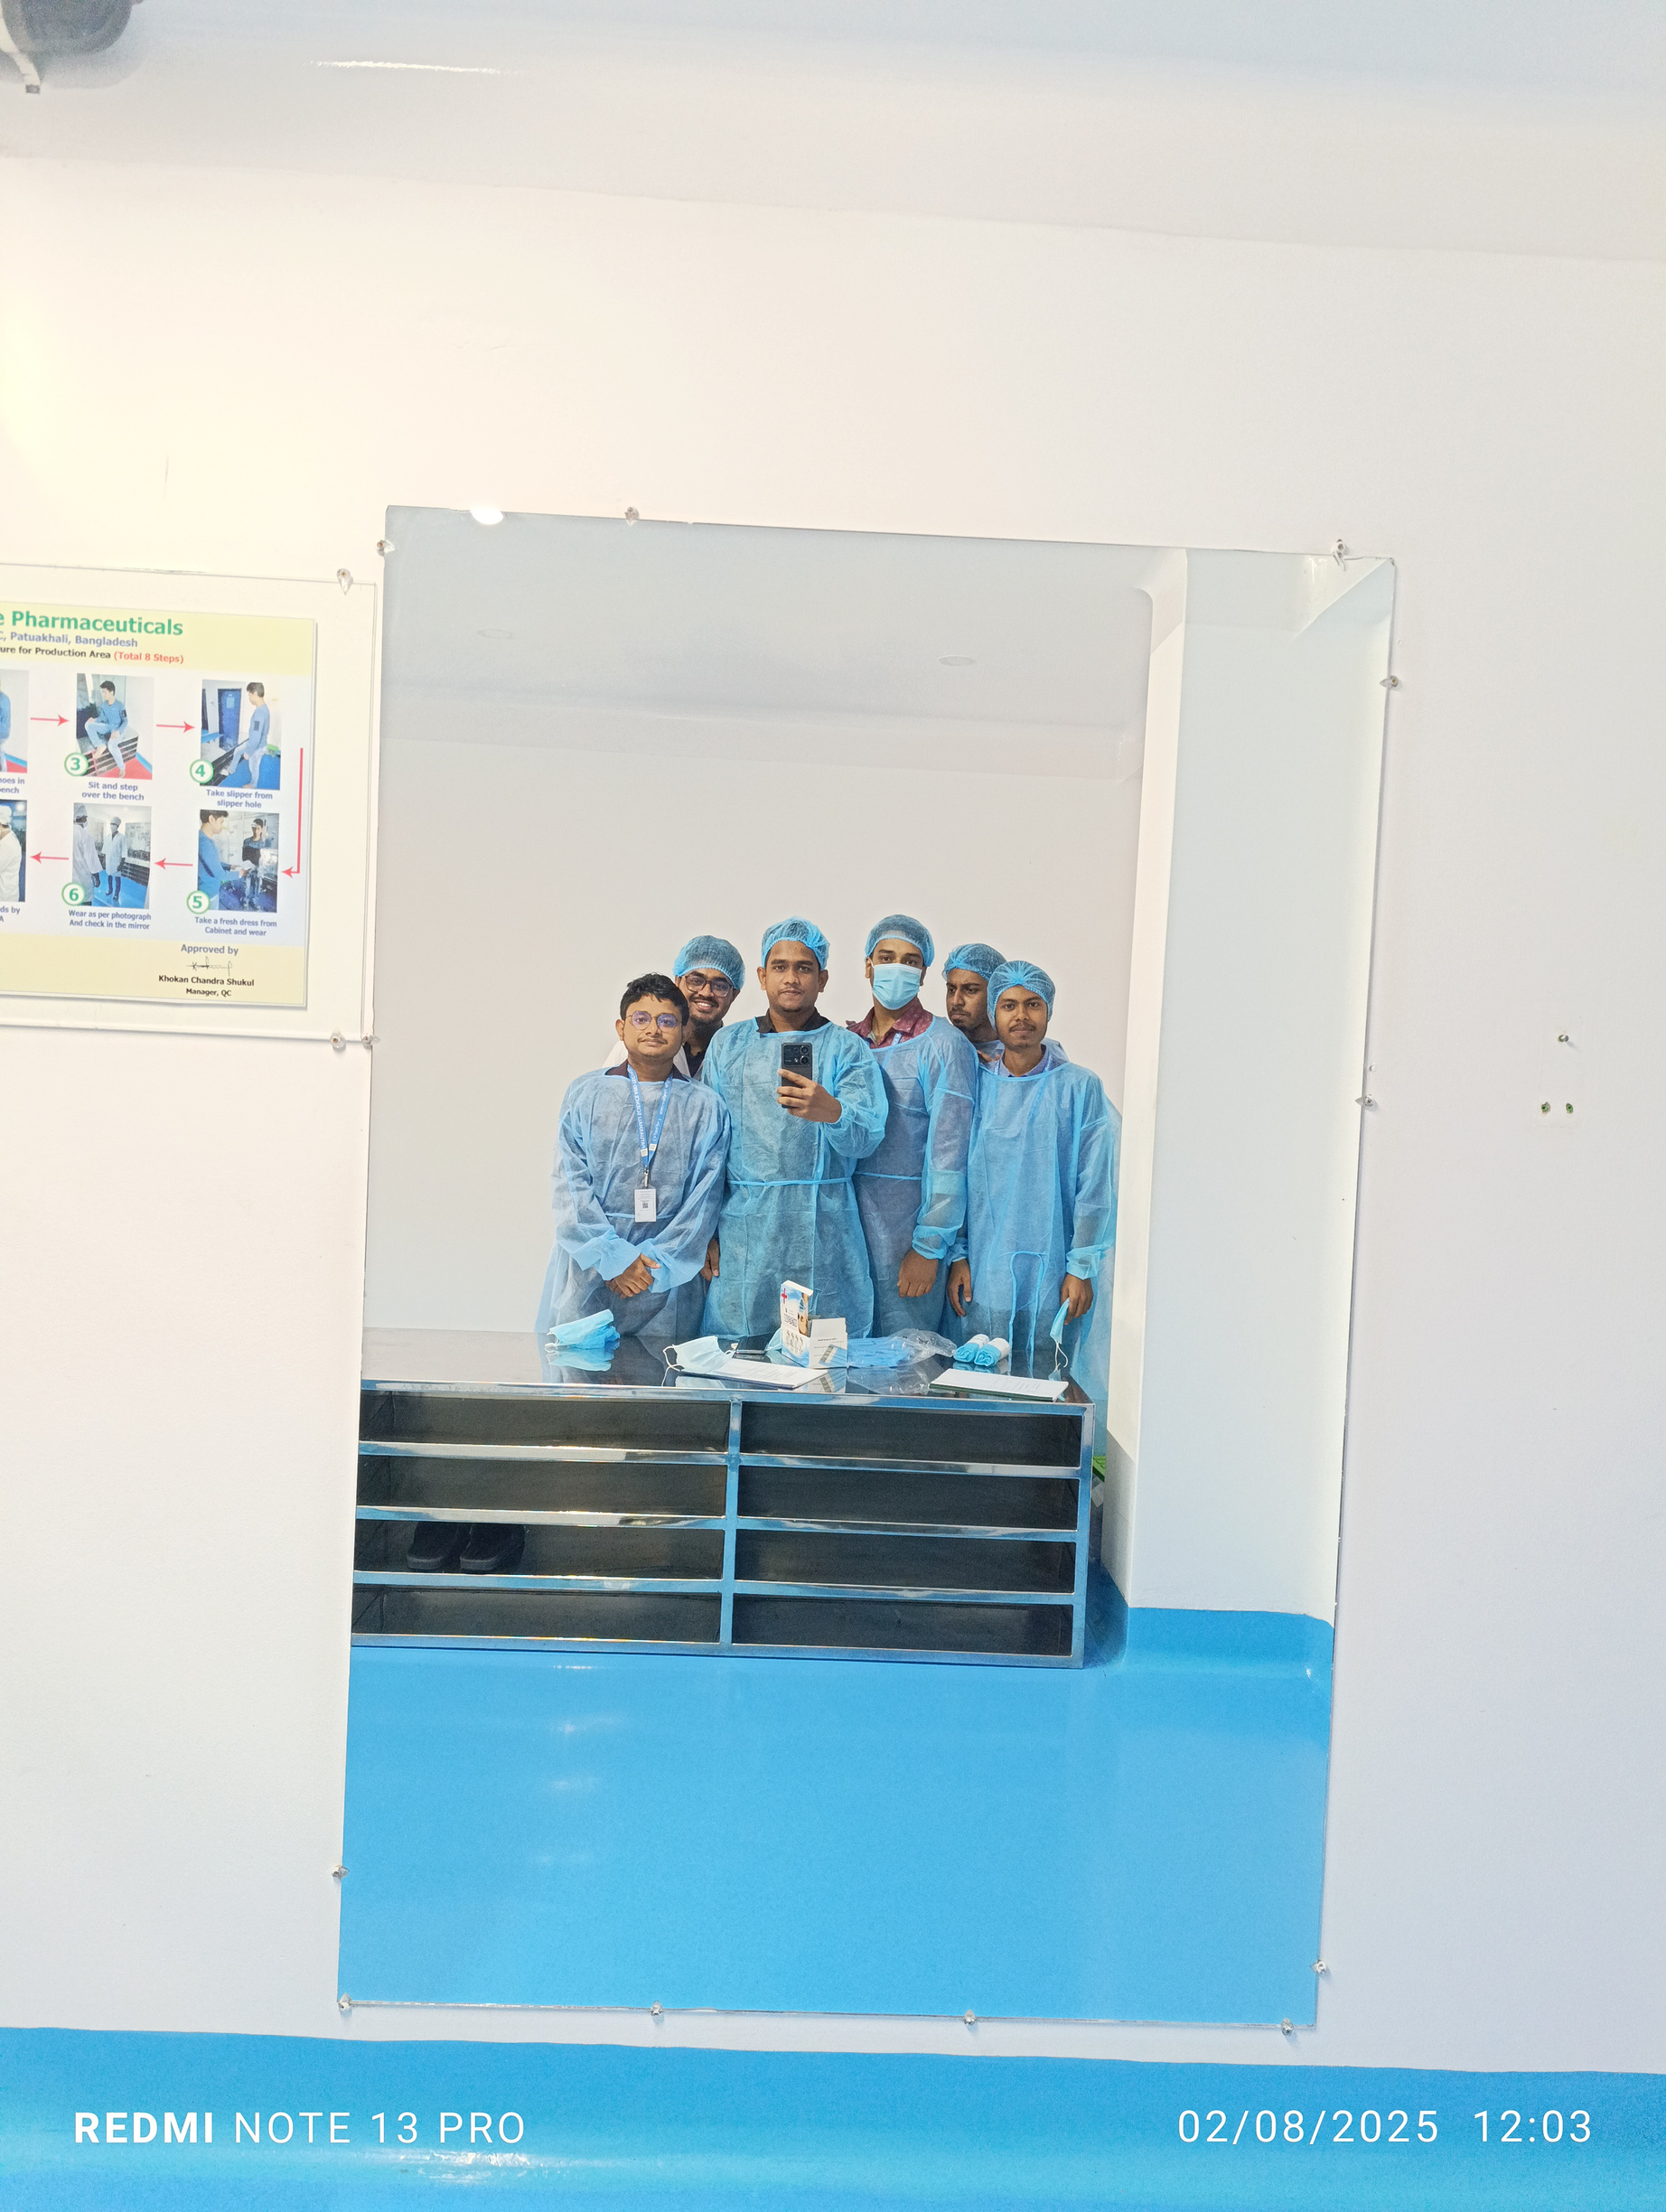

Welcome To
Pristine Pharmacuticals Ltd.

Slide 2

Pharmaintel
Home
Dashboard
logout
Presented by :
MD. MEHEDI HASAN
ID: 2102016
REG: 10143

Slide 3
Pristine Pharmacuticals Ltd.
Pristine Pharmaceuticals Limited is a well-structured pharmaceutical company based in Patuakhali, Bangladesh. It is involved in medicine production, raw material handling, quality control, and overall enterprise management. With its modern approach and efficient operations, the company provides a real-world example suitable for system analysis and process improvement studies.

Slide 4
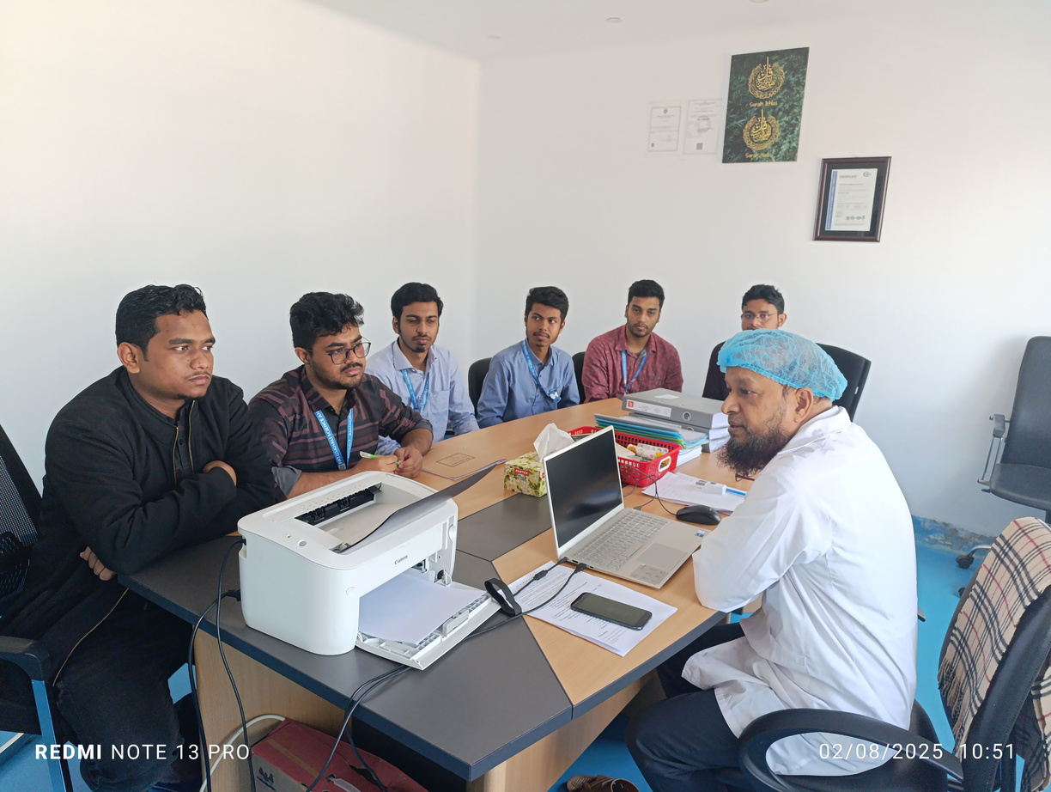
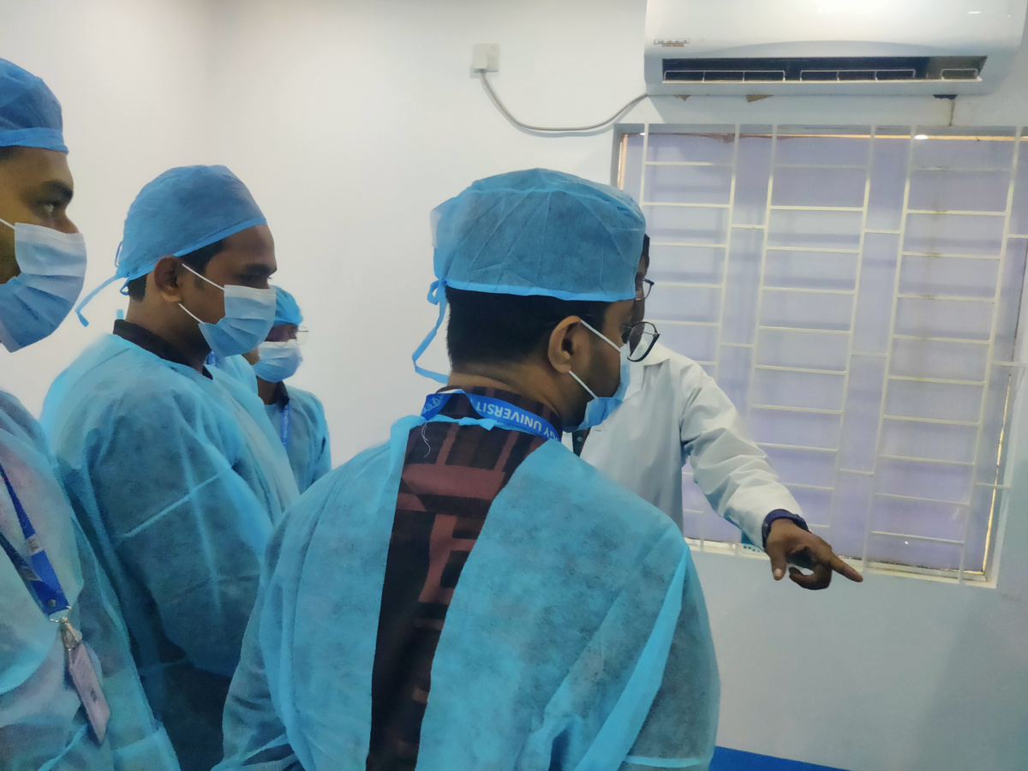
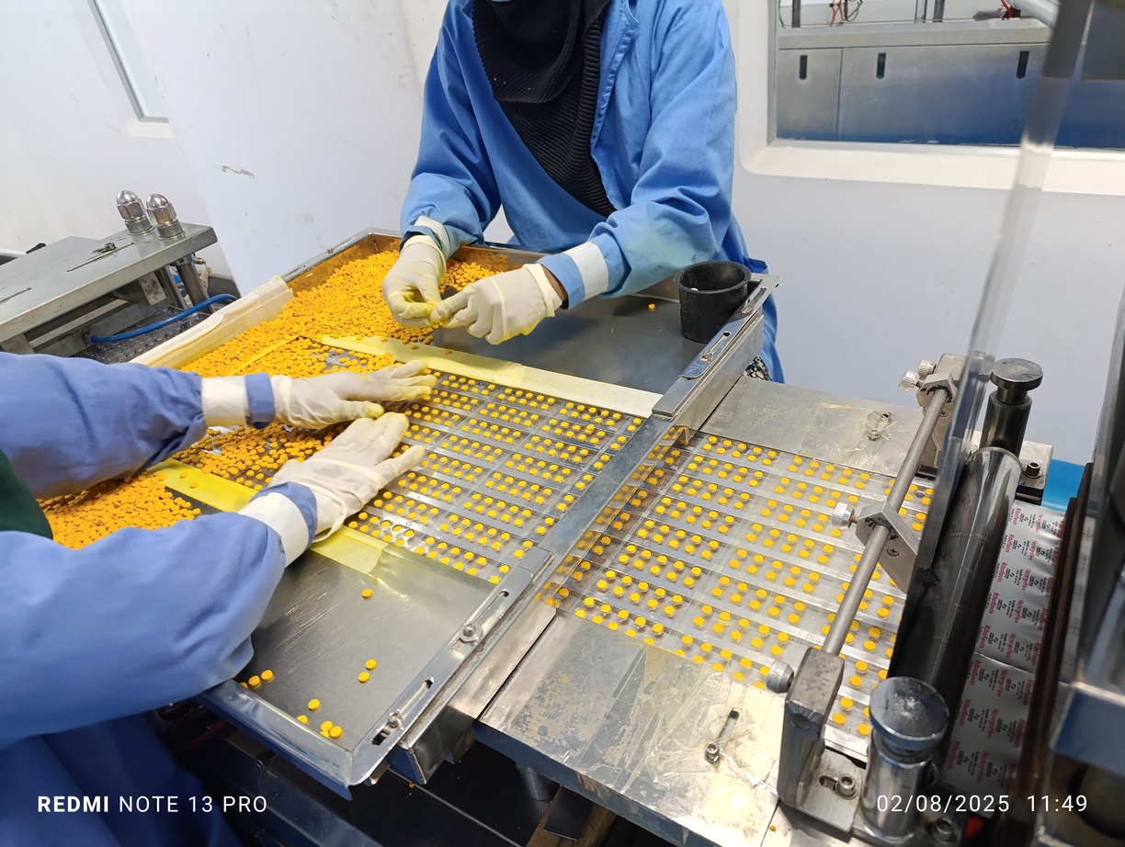
Pristine Pharmacuticals Ltd.
Company Visit

Slide 5
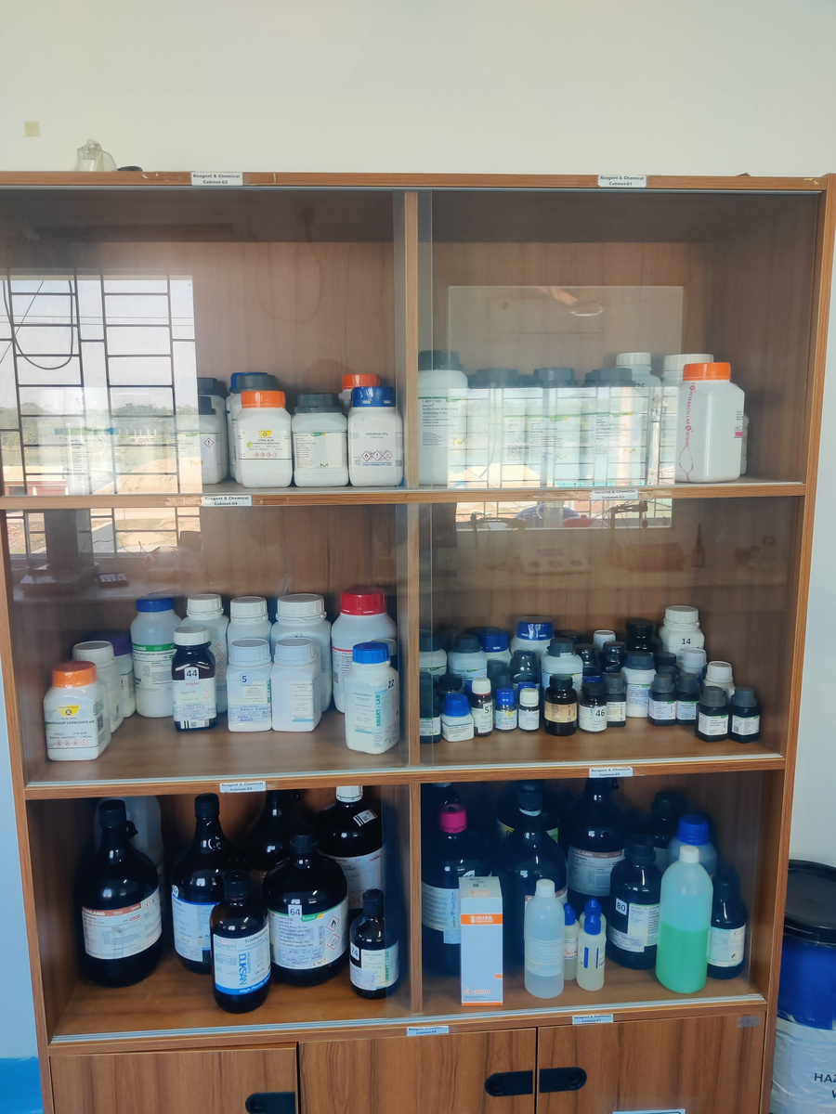
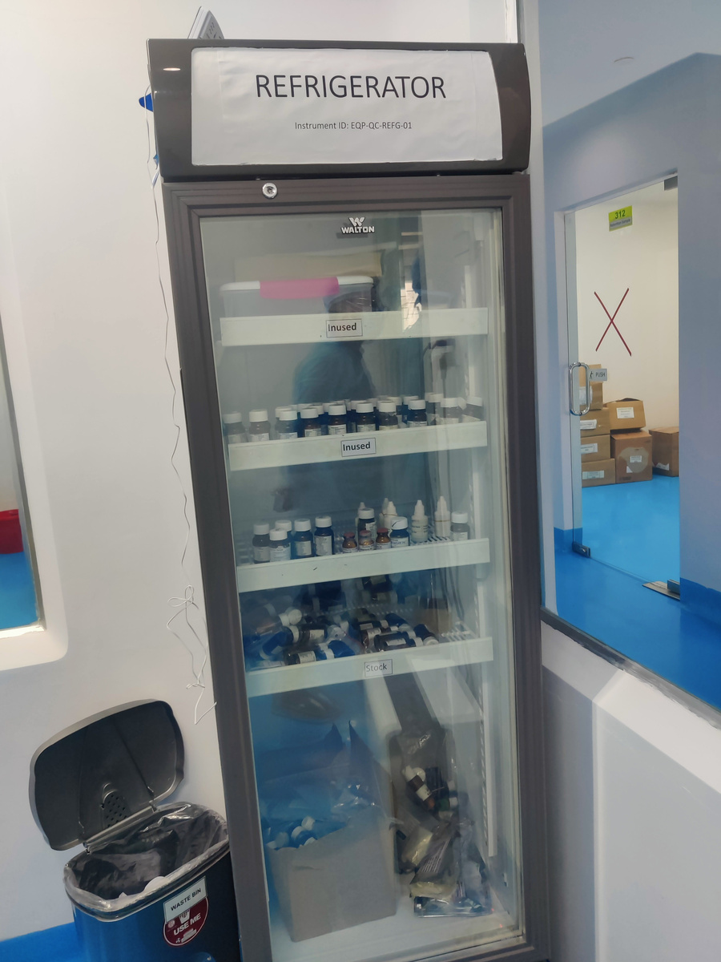
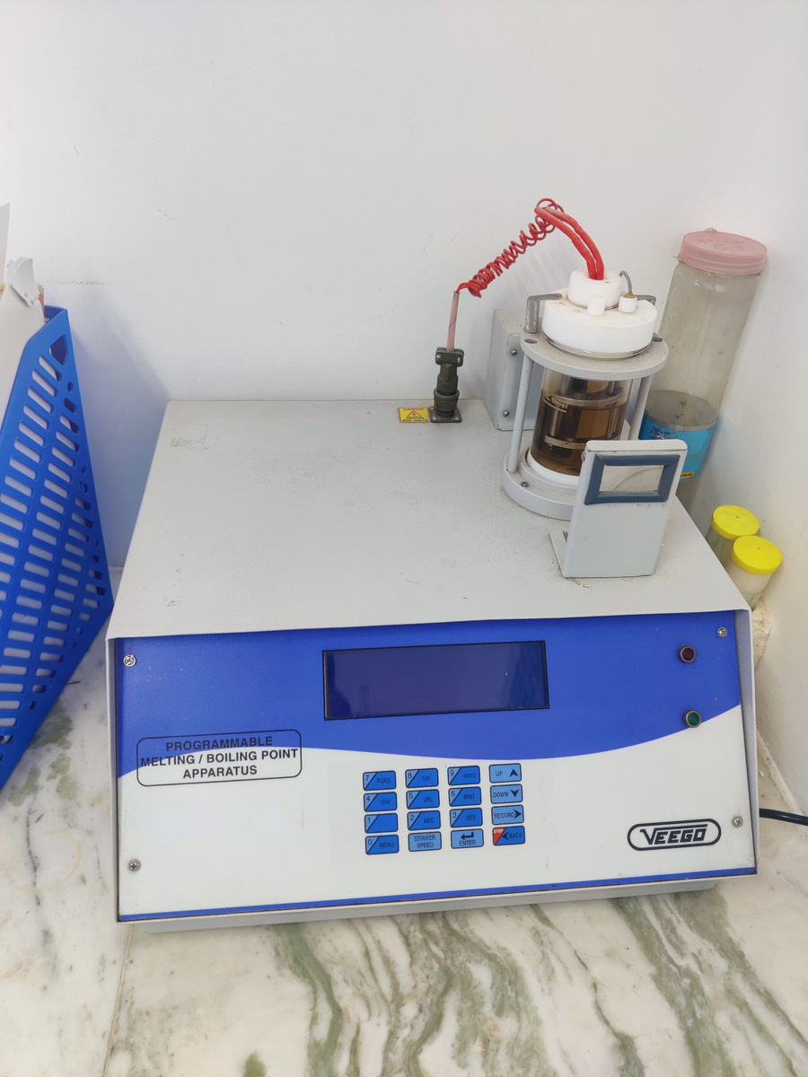
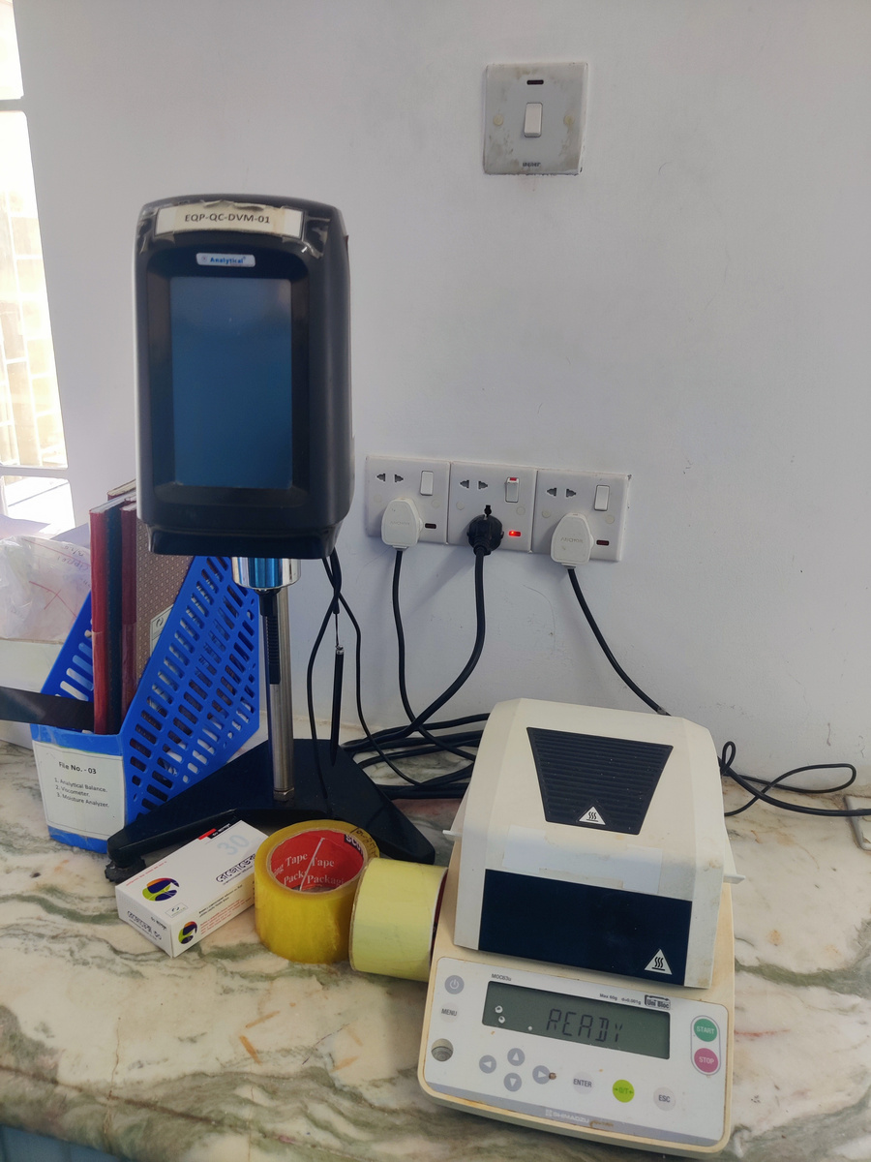
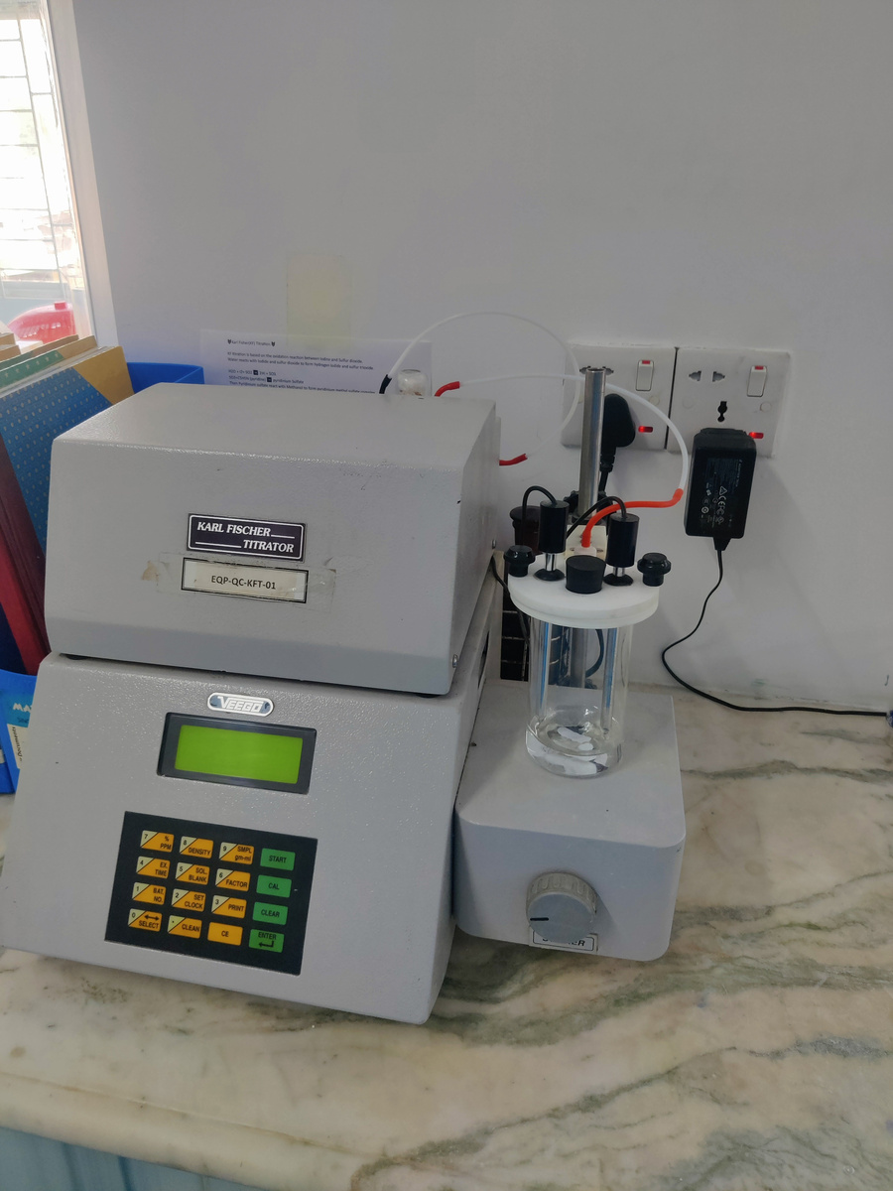
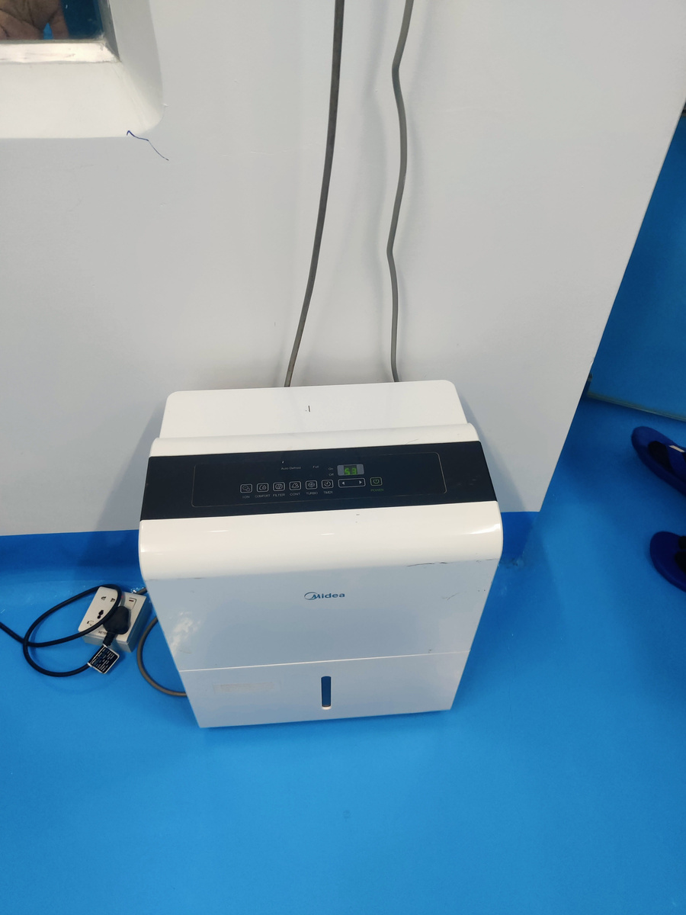
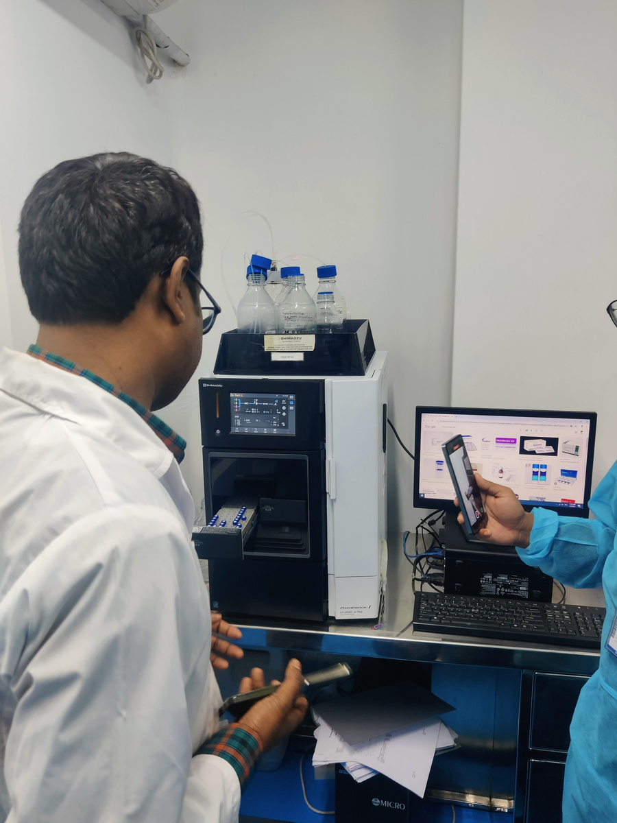
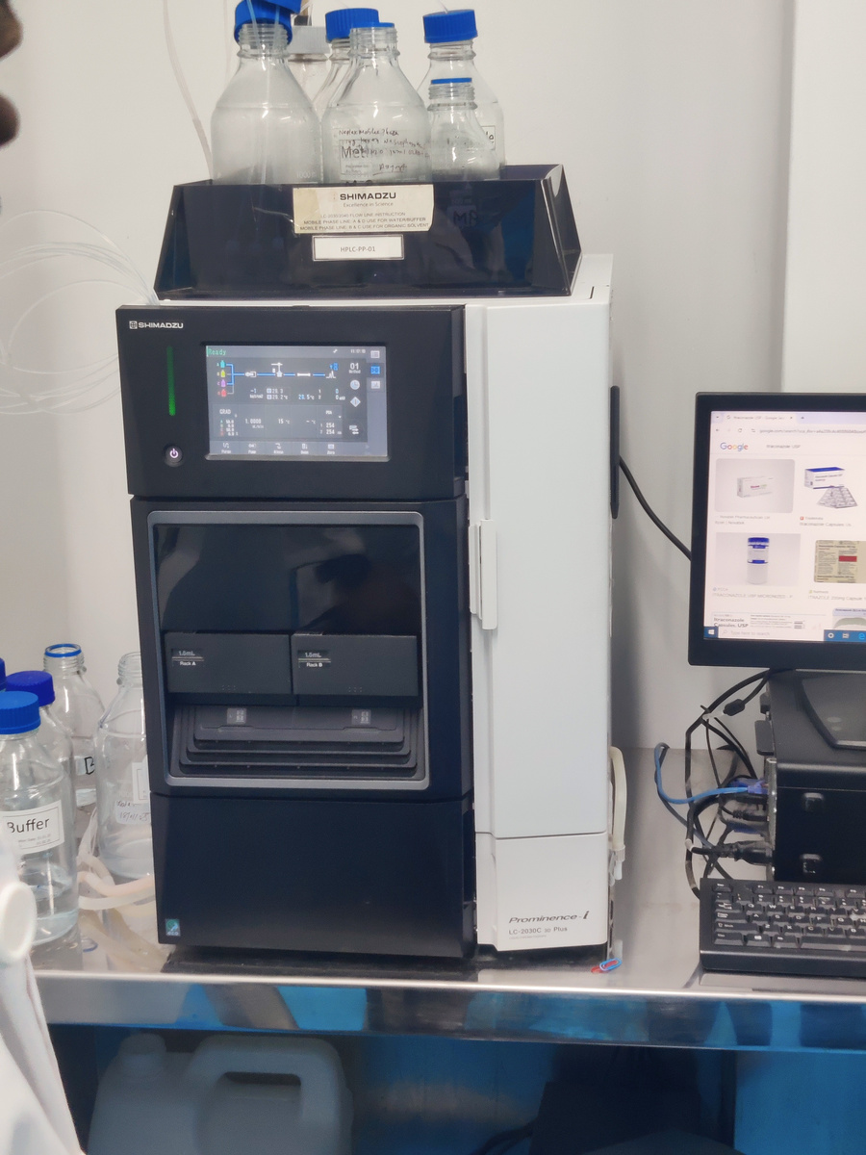
Raw Materials
Raw Materials And Chemical
Freezing
Boiling Point Appartus
QC Matchine
Karl Fischer Titratior
Auto Defcusl
High Performance Liquied Choromotography
High Performance Liquied Choromotography

Slide 6

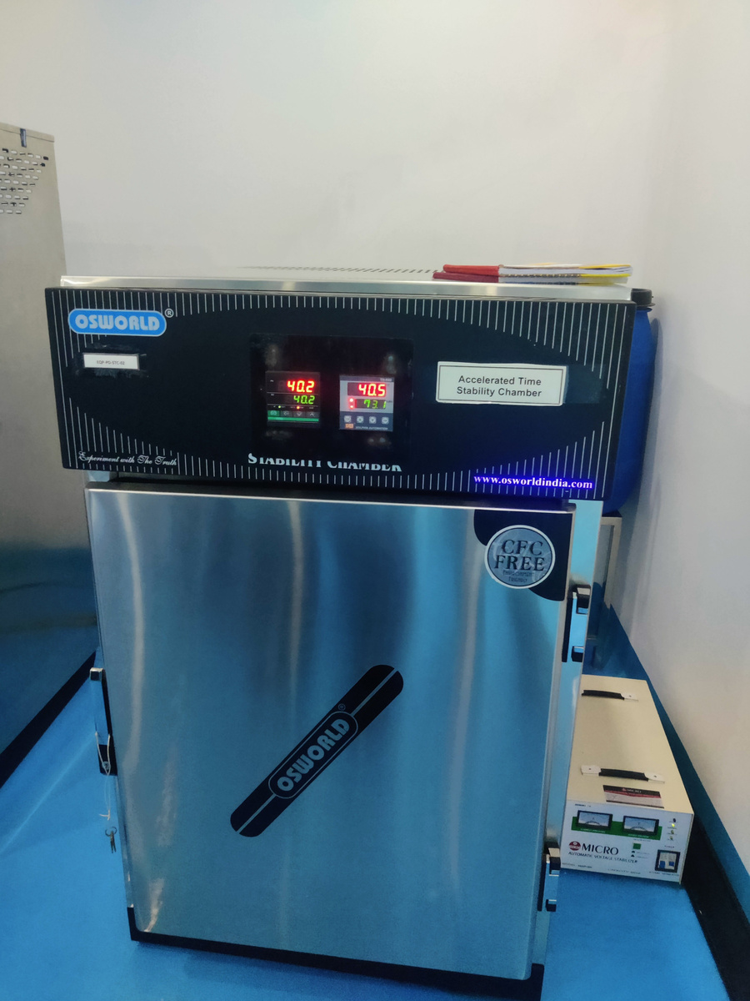
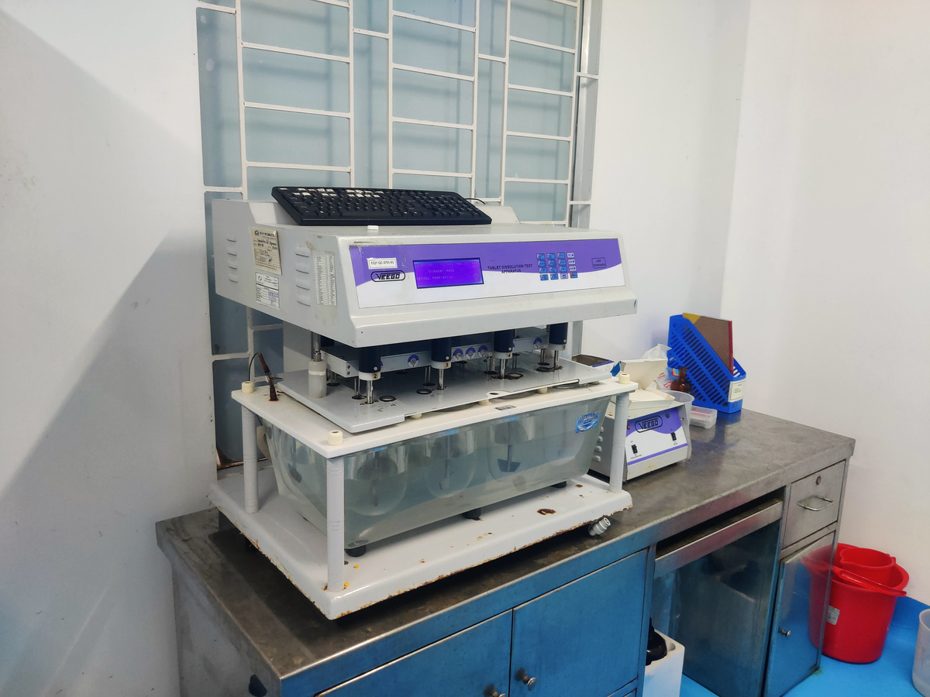
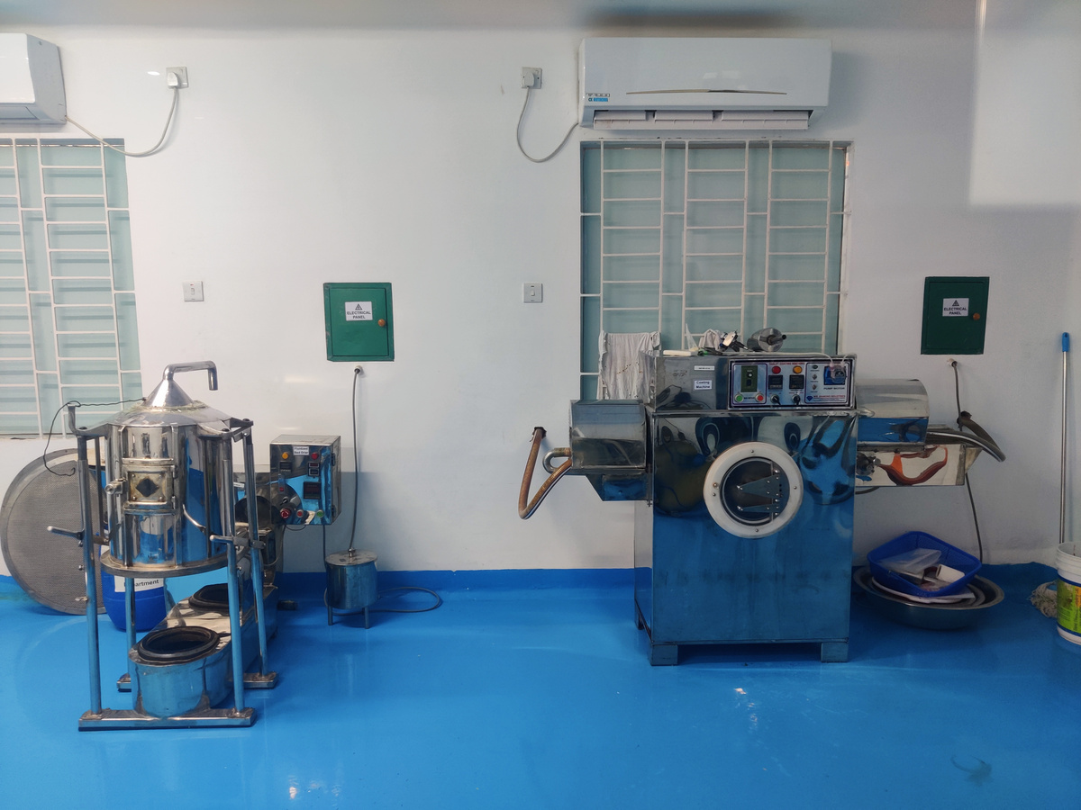
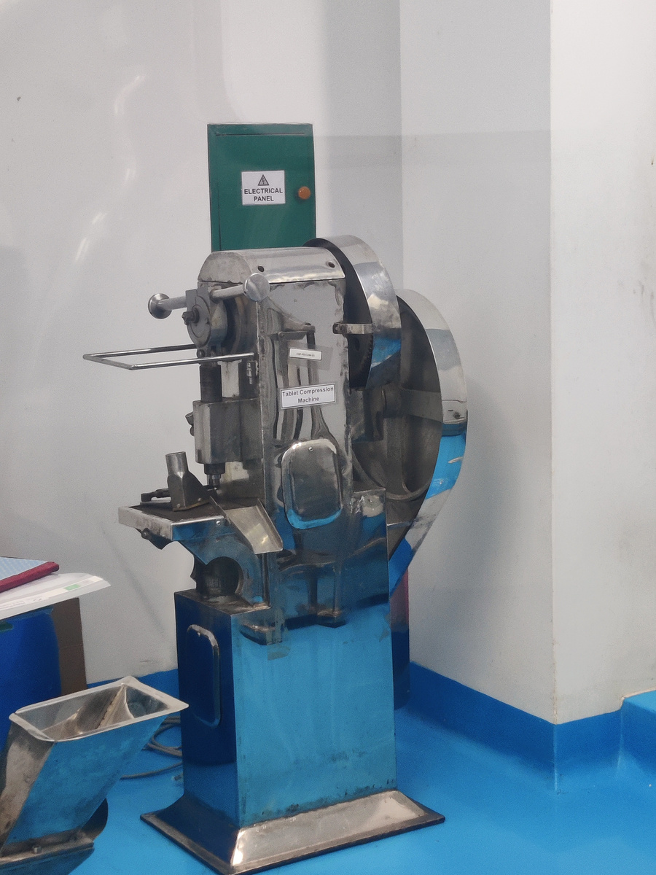
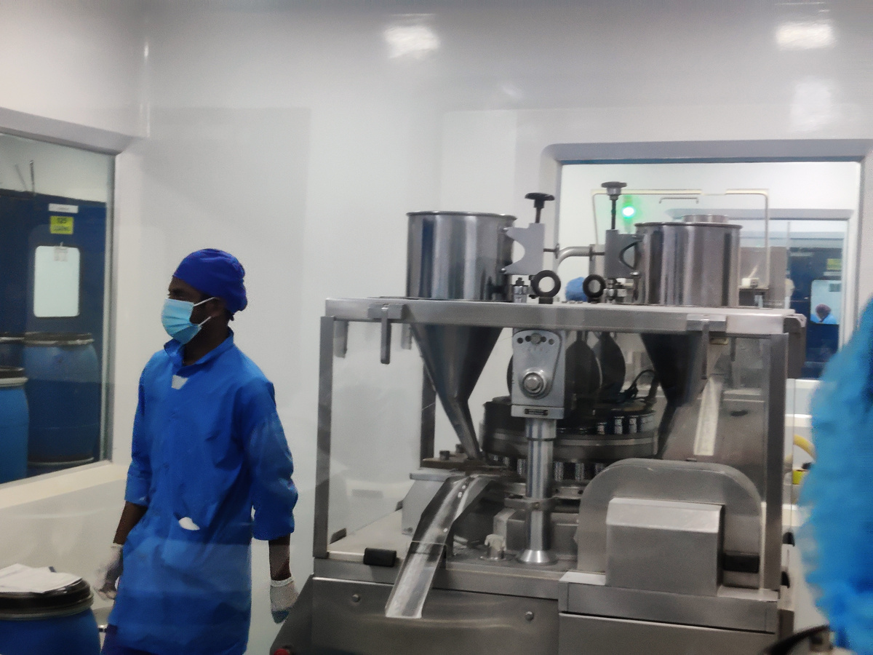
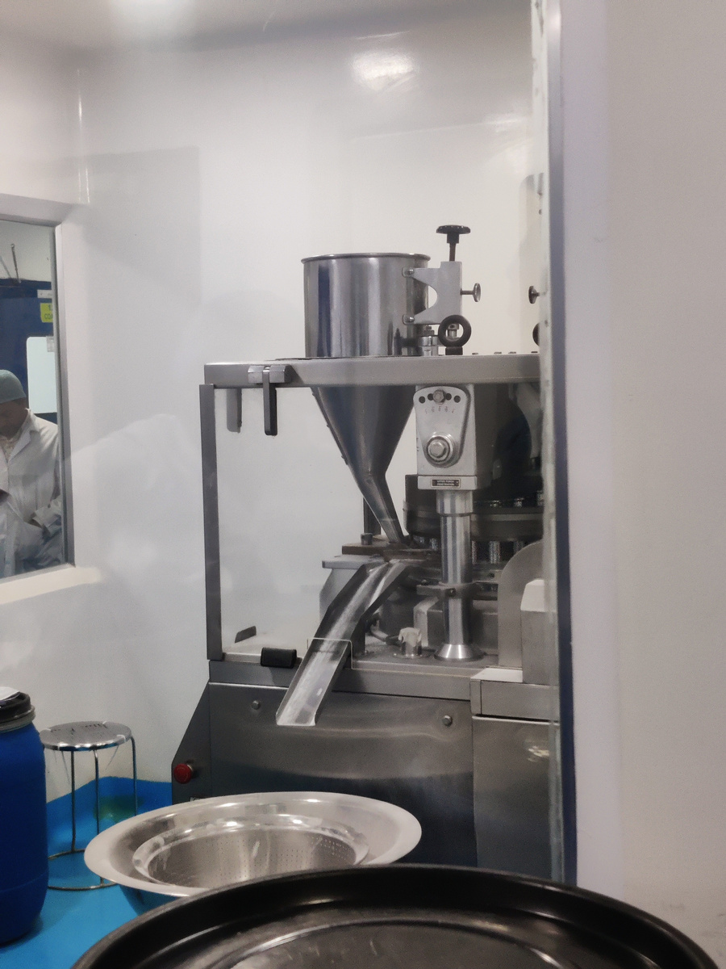
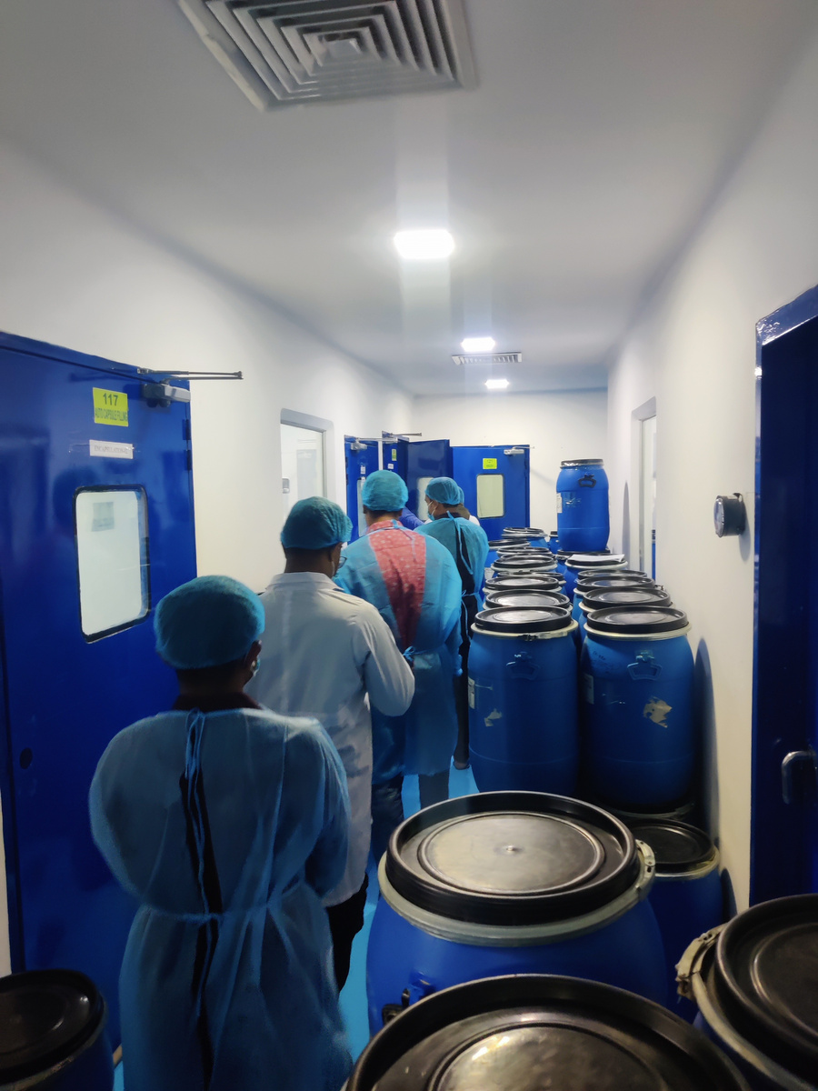
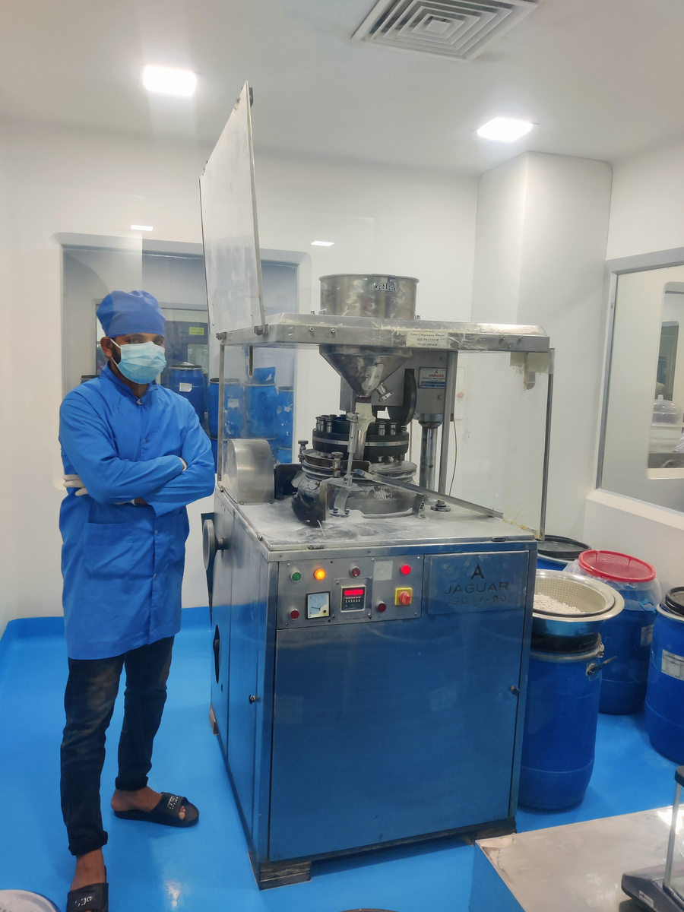
Raw Materials Manufacturing
Stability Testing Matchine
Differential Thermal Analysis
Coating Machine
Tablate Compression matchine
Compression Matchine
Compression Matchine
Warehouse
Compression Matchine

Slide 7
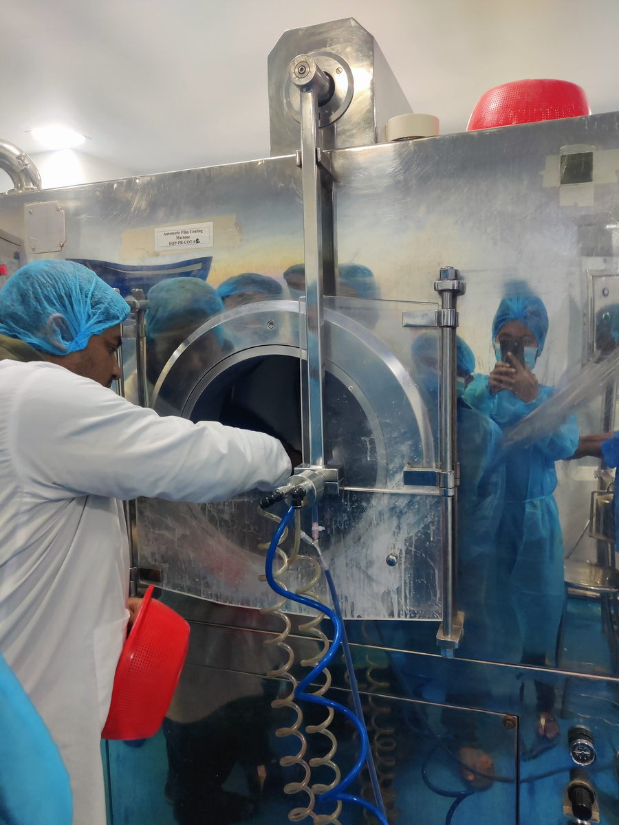
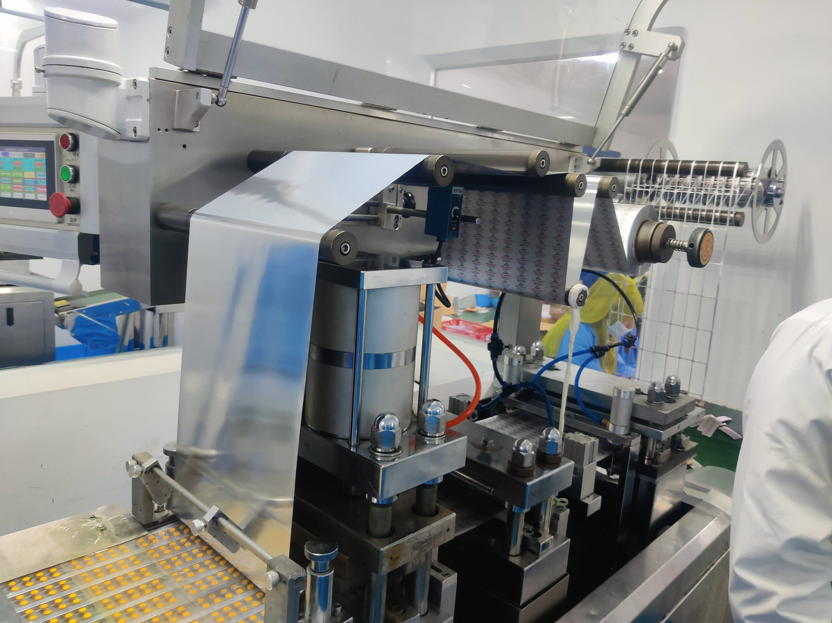
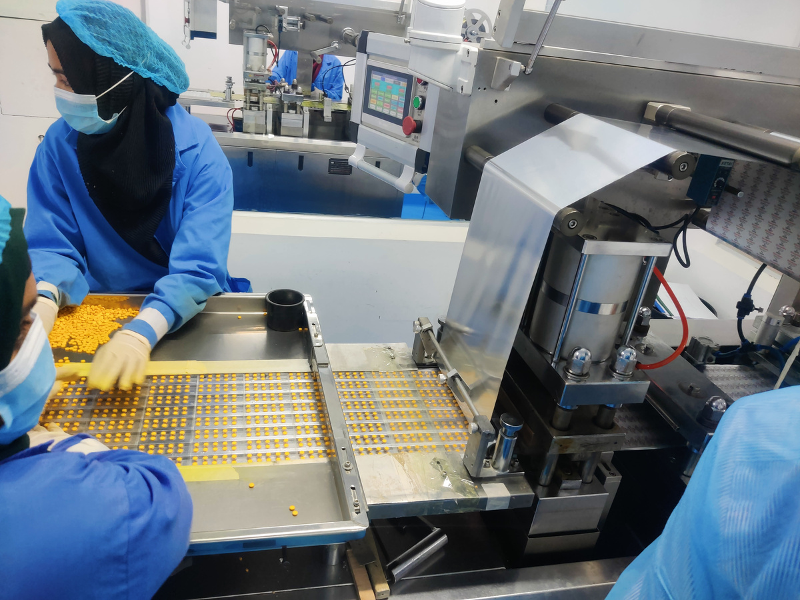
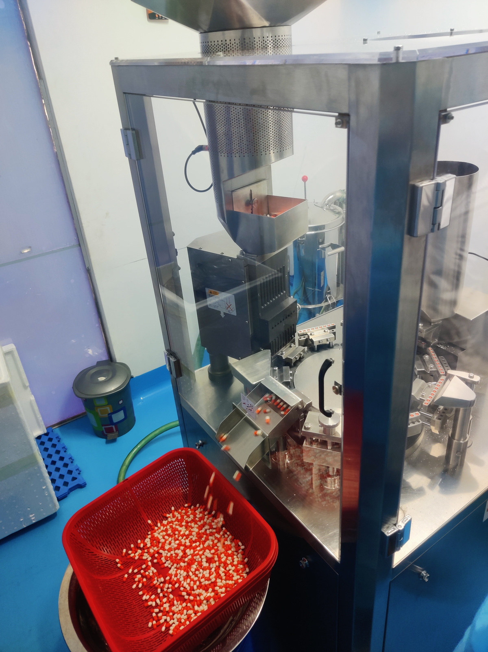
Manufacturing Production
Stability Testing Machine
Differential Thermal Analysis
Automatic Flim Coating Matchine
Tablate Compression matchine
Compression matchine
Flim Coating
Tablate Filling
Capsule Production

Slide 8
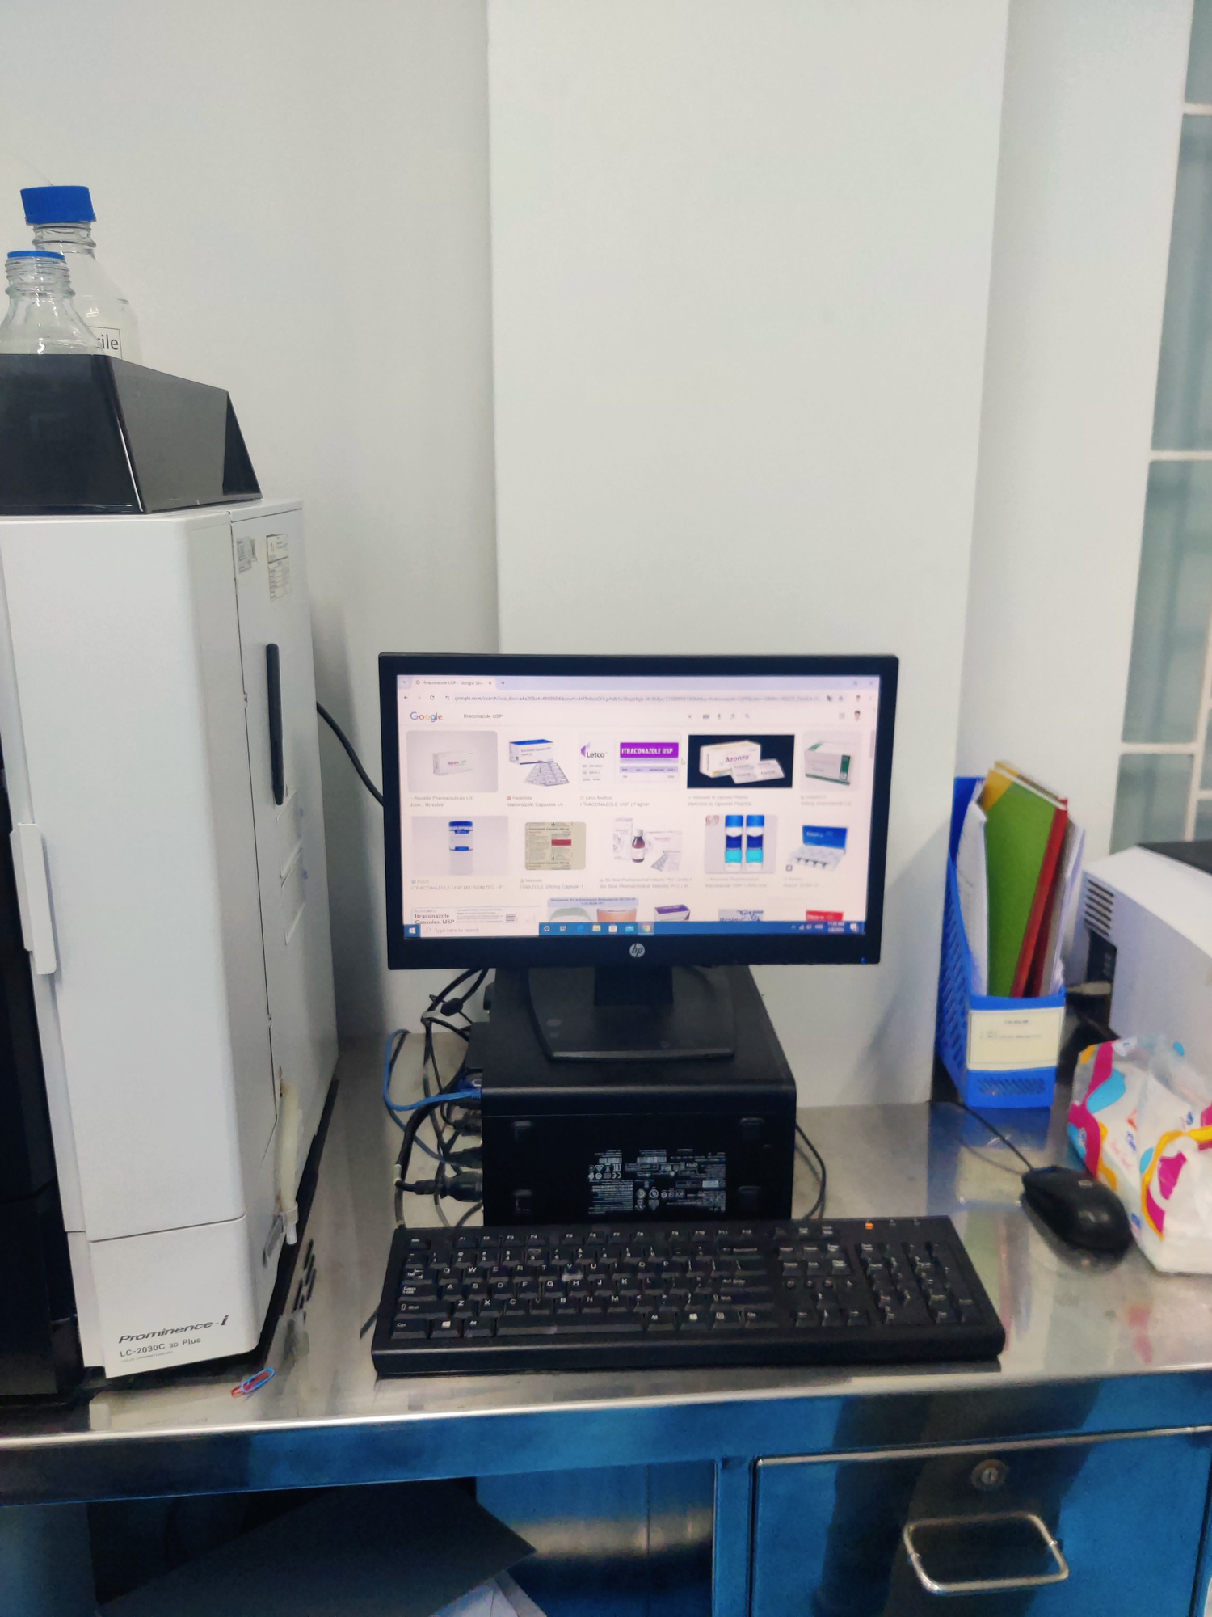
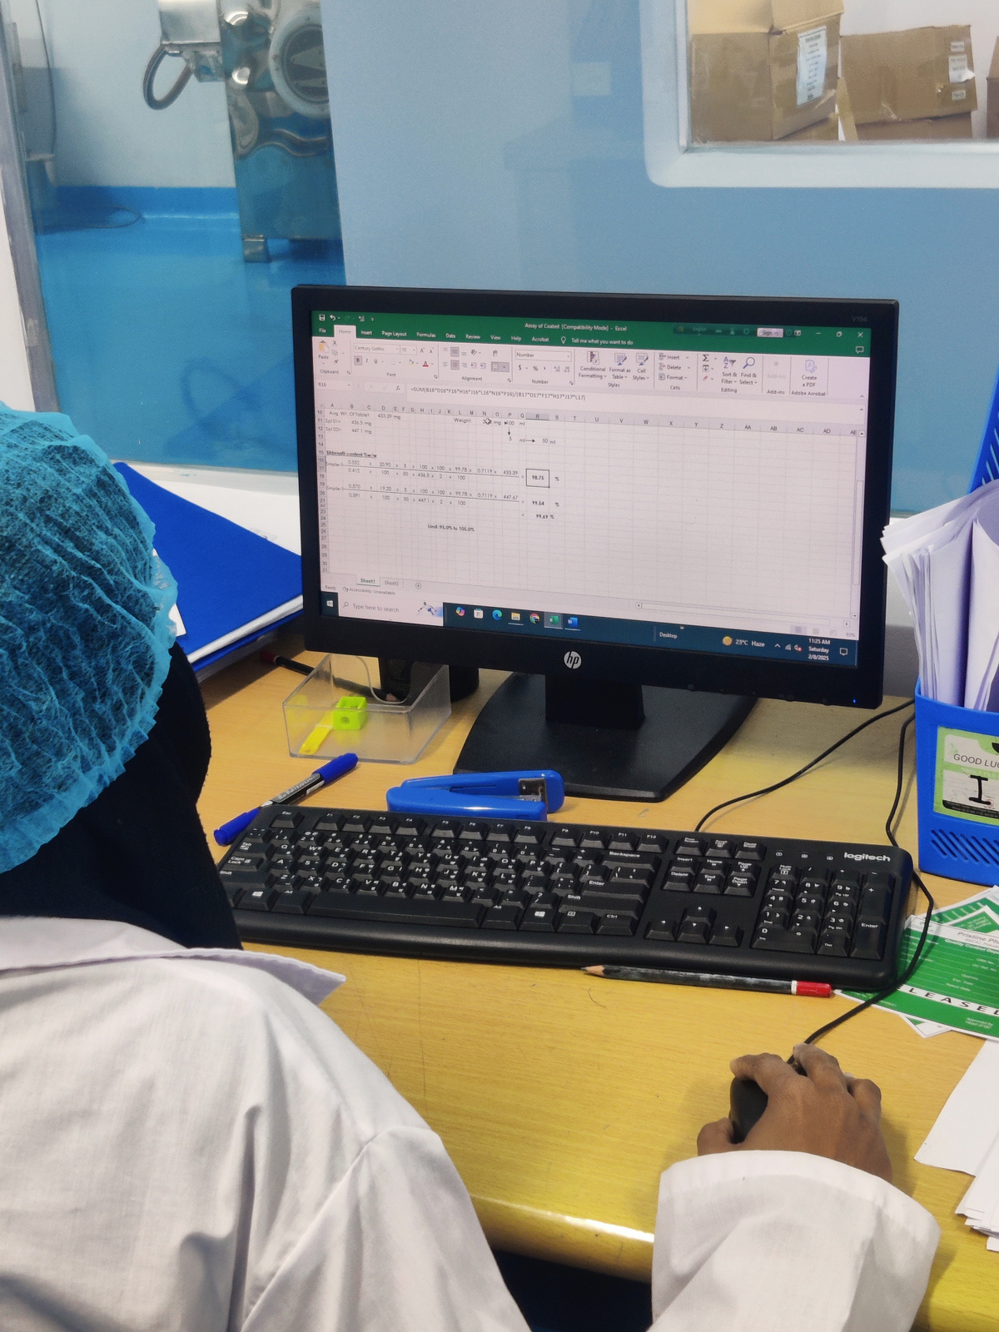
website
website
Data Entry

Slide 9
Home
Dashboard
logout
PharmaIntel
INTRODUCTION
PharmaIntel is a complete pharmaceutical management system that supports medicine manufacturing, inventory tracking, and sales management. It helps pharmaceutical companies maintain efficiency, accuracy, and compliance in their daily operations.

Slide 10
Pharmaintel
Home
Dashboard
logout
Business Model of Our Project
Our project follows a B2B (Business to Business) model. That means we aim to provide our software solution to pharmaceutical manufacturing companies to streamline and simplify their operations.
License-Based Subscription We will offer the software as a licensed product with monthly or yearly subscription plans.
Customization Services We can customize the system based on the specific needs of different pharmaceutical companies.
Data Security & Analytics We ensure secure handling of business data and provide insightful analytics to help companies make better decisions.

Slide 11
Pharmaintel
Home
Dashboard
logout
Technology Uses
Backend: C# with ASP.NET Core MVC & Web API
Frontend: CSS / JavaScript Database: MySQL Authentication: ASP.NET Identity or custom role-based login
www.pharmaintel.com

Slide 12
Pharmaintel
Home
Dashboard
logout
Main Features
•Role-based Access (Admin/Salsemanager/Analyst)
•Product Entry and Management
•Sales Entry and Reporting
•Inventory Monitoring
•Dynamic Dashboard
•Data Export and Reporting
www.pharmaintel.com

Slide 13
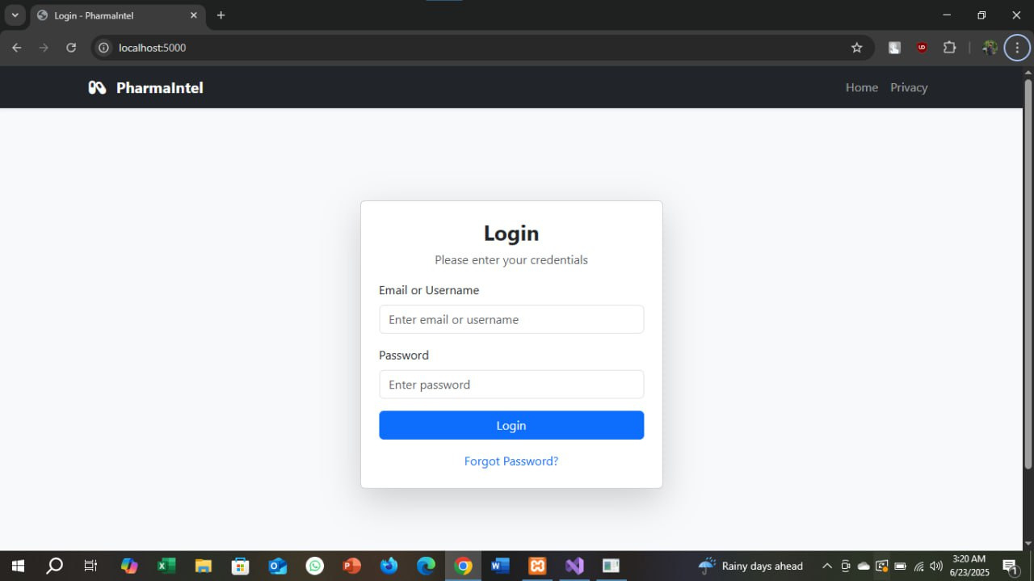
Pharmaintel
Home
Dashboard
logout
Login Page
Role-based Access
Admin
Salsemanager
Analyst
www.pharmaintel.com

Slide 14
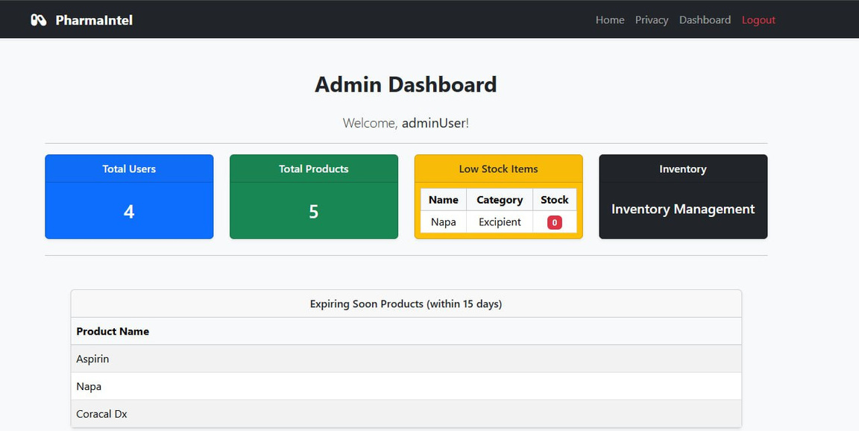
Pharmaintel
Home
Dashboard
logout
Admin Dashboard
Manage All the page
Overview of total medicines, orders, raw materials
Daily/Monthly Sales Reports

Slide 15
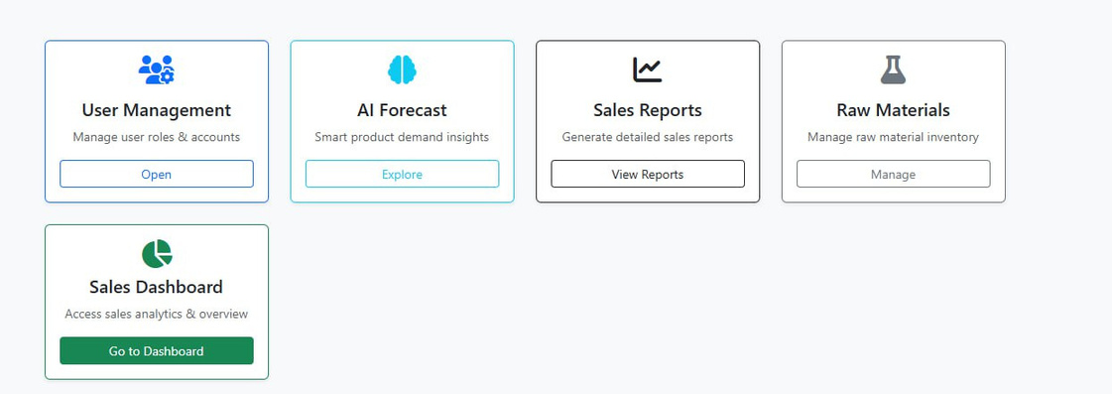
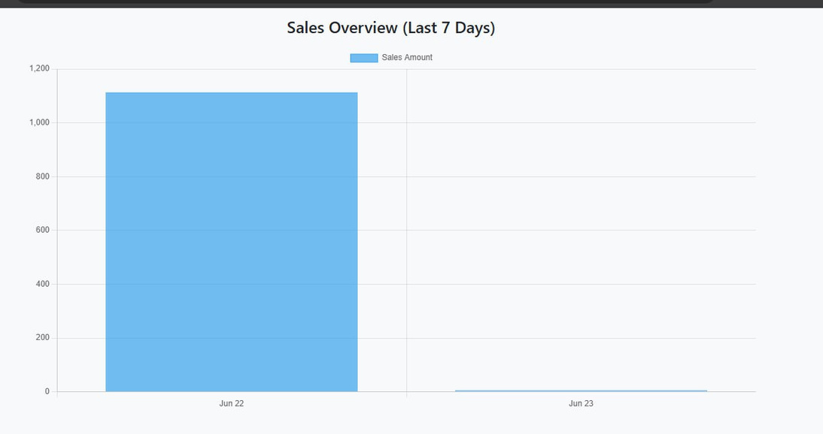
Pharmaintel
Home
Dashboard
logout
Admin Dashboard
Manage All the page
Overview of total medicines, orders, raw materials
Daily/Monthly Sales Reports

Slide 16
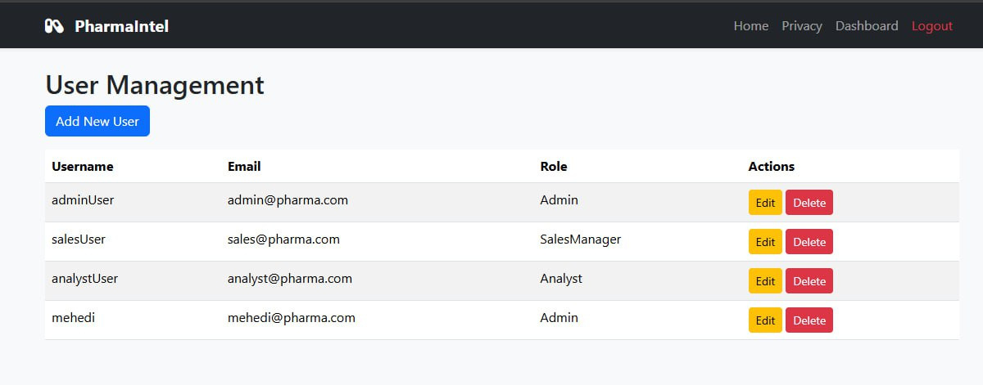
Pharmaintel
Home
Dashboard
logout
Admin Dashboard Features

Slide 17
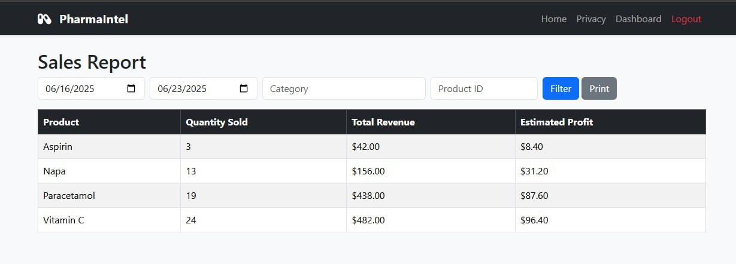
Pharmaintel
Home
Dashboard
logout
Admin Dashboard Features

Slide 18
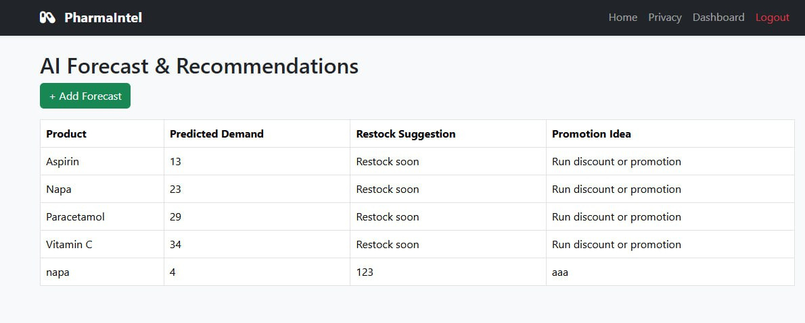
Pharmaintel
Home
Dashboard
logout
Admin Dashboard Features

Slide 19
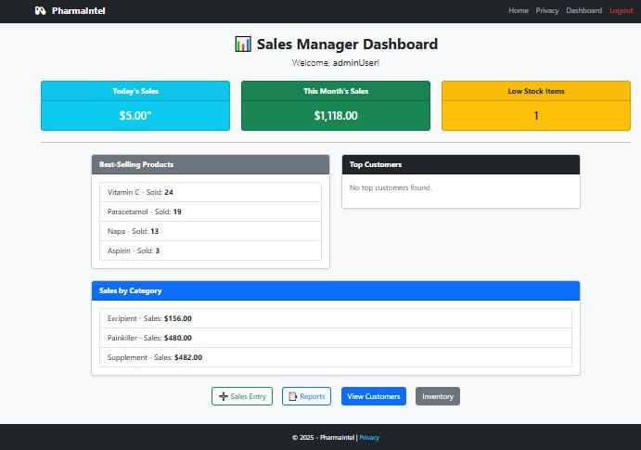
Pharmaintel
Home
Dashboard
logout
Sales Manager Dashboard

Slide 20
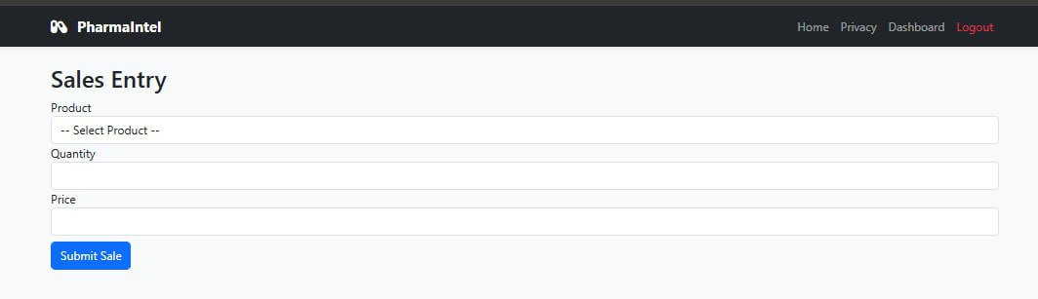
Pharmaintel
Home
Dashboard
logout
Sales Manager Dashboard

Slide 21
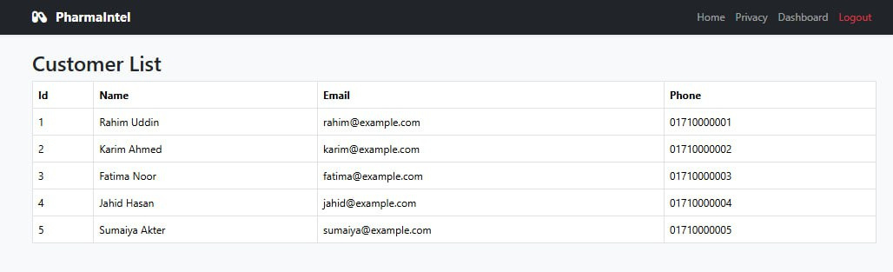
Pharmaintel
Home
Dashboard
logout
Sales Manager Dashboard

Slide 22
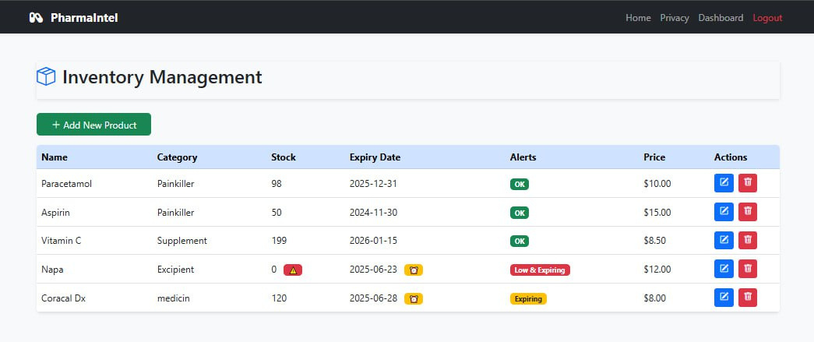
Pharmaintel
Home
Dashboard
logout
Sales Manager Dashboard

Slide 23
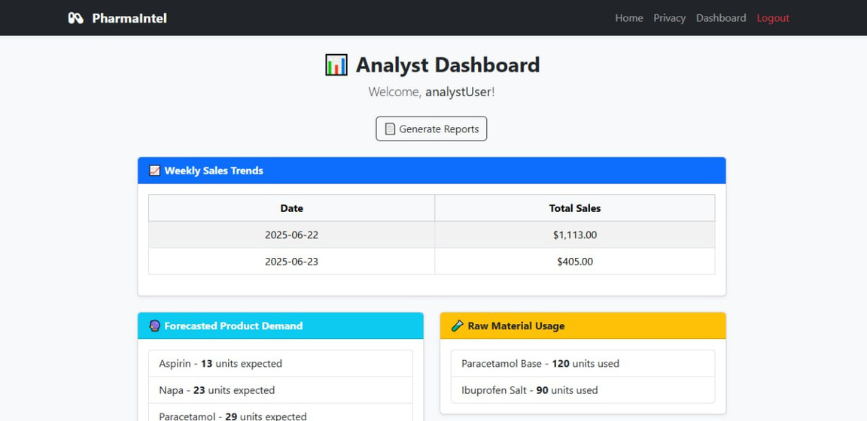
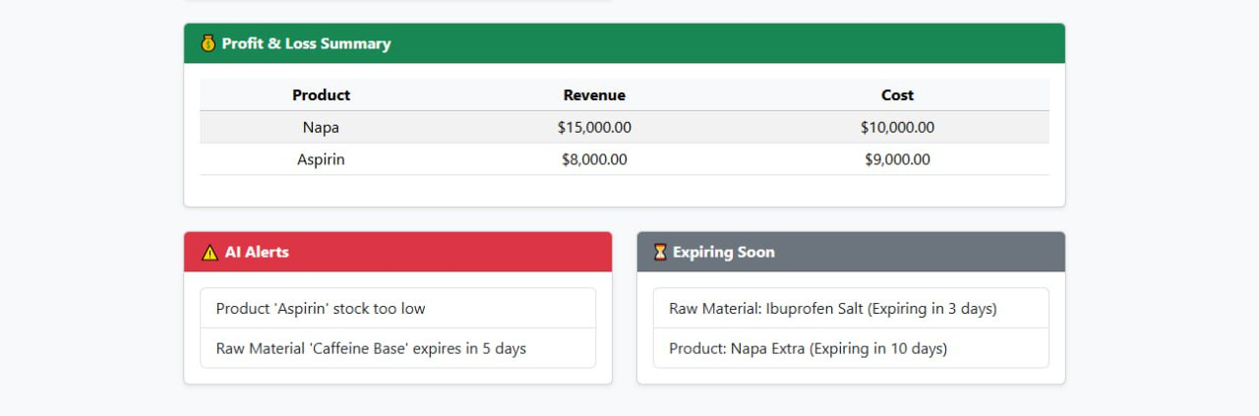
Pharmaintel
Home
Dashboard
logout
Analyst Dashboard
Weekly/monthly sales trends
Forecast demand charts
AI-driven recommendations summary

Slide 24
Pharmaintel
Home
Dashboard
logout
Future AI Features
APPs
Demand Forecasting
Smart Recommendations
Chatbot Support
AI Analytics Dashboard
Predictive Maintenance

Slide 25

Pharmaintel
Home
Dashboard
logout
Thank You
www.pharmaintel.com

